Slide 1
Python Modules & Packages
Session 6

Slide 2
Objectives
Modules
Packages

Slide 3

Python - Modules
A module allows you to logically organize your Python code. Grouping related code into a module makes the code easier to understand and use. A module is a Python object with arbitrarily named attributes that you can bind and reference.
Simply, a module is a file consisting of Python code. A module can define functions, classes and variables. A module can also include runnable code.
Example
  The Python code for a module named aname normally resides in a file named aname.py. Here's an example of a simple module, support.py
The import Statement
  You can use any Python source file as a module by executing an import statement in some other Python source file. The import has the following syntax −

Slide 4
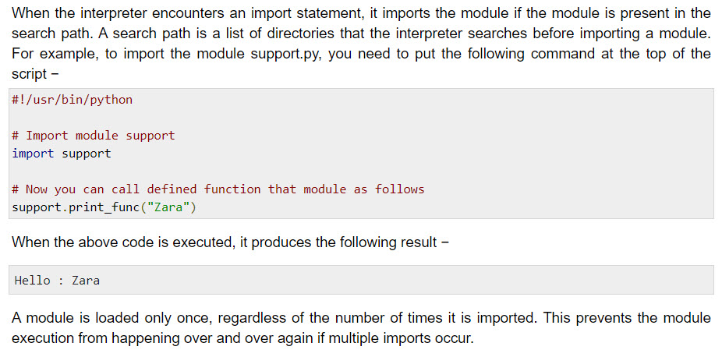
Python - Modules

Slide 5
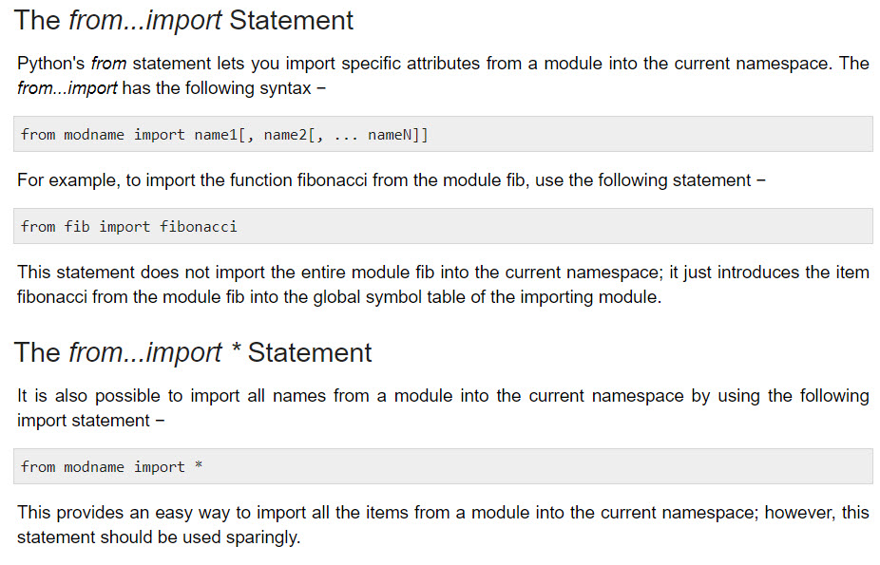
Python - Modules

Slide 6
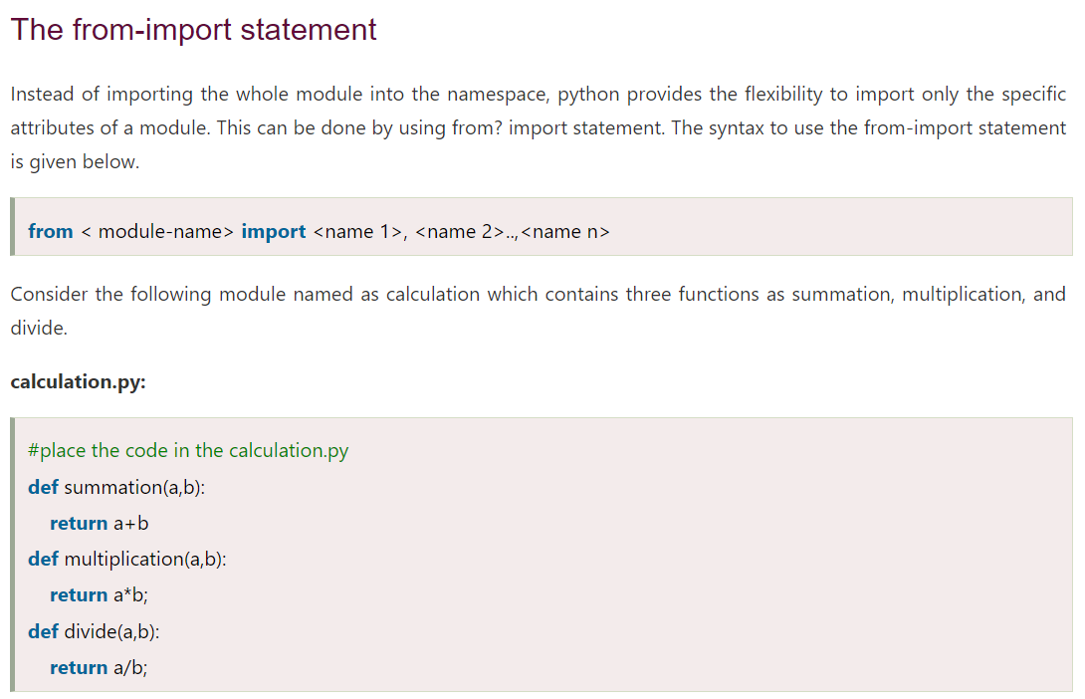
Python - Modules

Slide 7
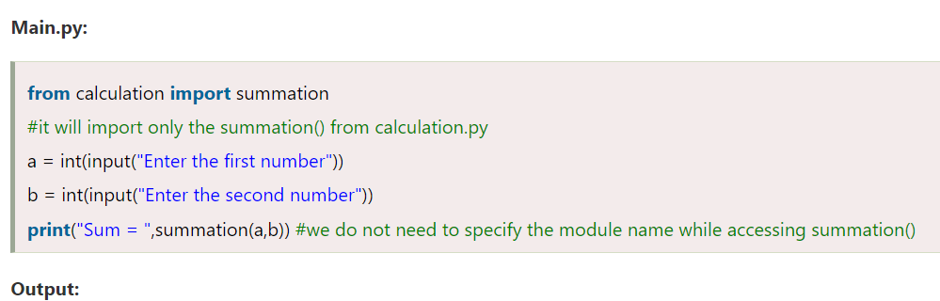
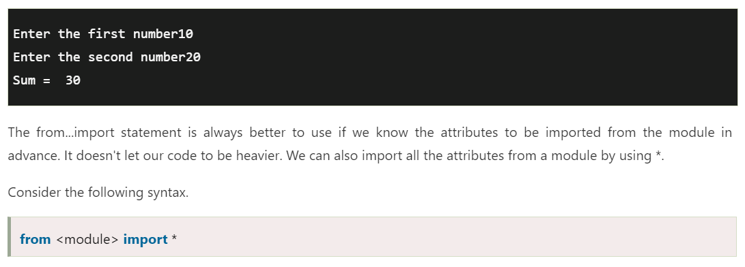
Python - Modules

Slide 8
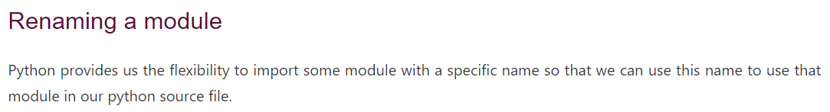
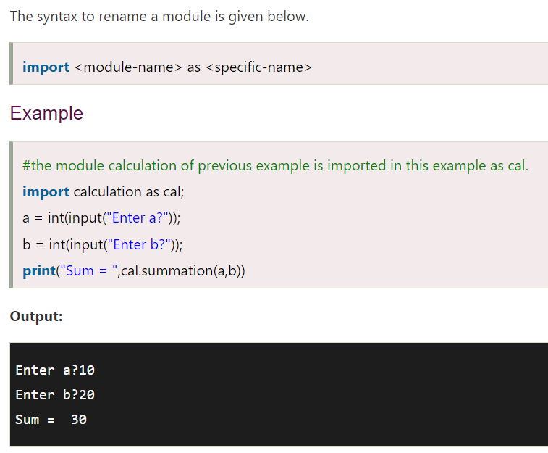
Python - Modules

Slide 9


Packages in Python
A package is a hierarchical file directory structure that defines a single Python application environment that consists of modules and subpackages and sub-subpackages, and so on.
Consider a file Pots.py available in Phone directory. This file has following line of source code −
Similar way, we have another two files having different functions with the same name as above −
  Phone/Isdn.py file having function Isdn()
  Phone/G3.py file having function G3()
Now, create one more file __init__.py in Phone directory −
  Phone/__init__.py
To make all of your functions available when you've imported Phone, you need to put explicit import statements in __init__.py as follows −

Slide 10
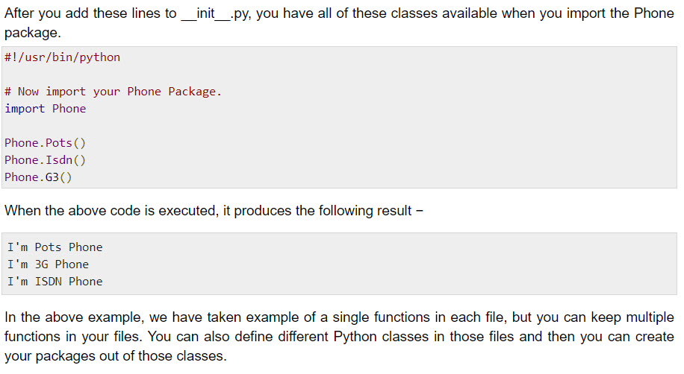
Packages in Python

Slide 11
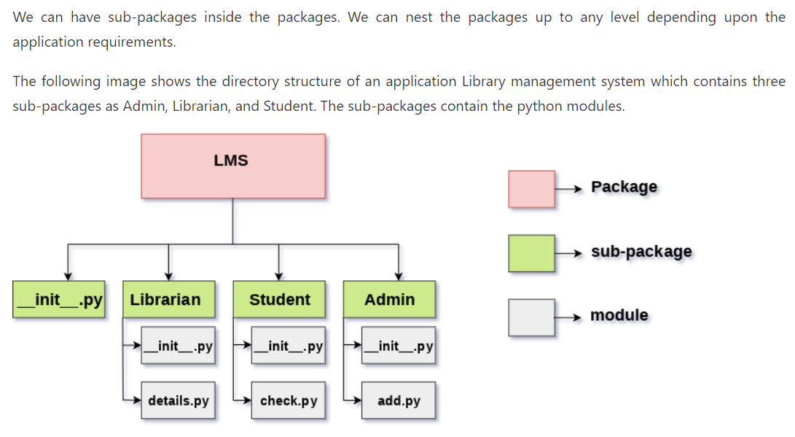
Python - Modules

Slide 12
Summary
Modules
Packages

